Slide 1

Amoun Language Schools School Management System (LMS)
Karim Ehab, Youssif Assem, Mohamed Moataz & Philip George
Supervised by: Dr. Essam Eliwa, Dr. Yomna Ibrahim Supervising Assistant: Eng. Nada Ayman
1

Slide 2
Agenda:
SOFTWARE ENGINEERING (SE305)
Introduction
Problem Statement
System Overview
Use Case Diagram
Functional Requirements
Non-Functional Requirements
Database Diagram
Class Diagram
Prototype
Live Demo
HUMAN COMPUTER INTERACTION (CSC341)
PACT Analysis
HTA
2

Slide 3
FIRST: SOFTWARE ENGINEERING

Slide 4
Introduction
4

Slide 5
Introduction:
When coronavirus conquered Earth at the end of 2019, all entities had gone online like: private and public companies, schools, universites, …etc.
No doubt, some education authorities in Egypt started e-learning especially universites. So, we decided to create not only learning system but also, a management one.
We believe that LMS in this pandemic time became something necessary all over the world.
5

Slide 6
Problem Statement
6

Slide 7
Problem Statement:
Online and e-learning systems for schools are a bit neglected. So when the pandemic hit our country. The online system was needed more than ever. It was not provided the way that the student needed it to be for him/her to benefit fully from it.
7

Slide 8
System Overview
8

Slide 9
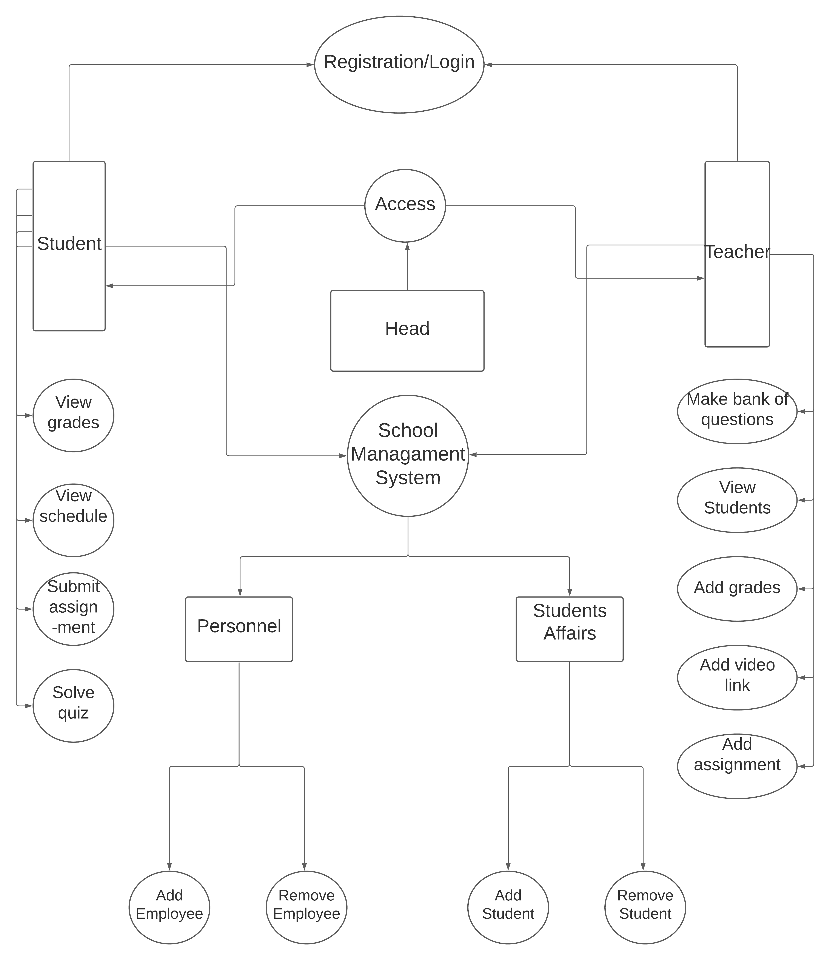
9

Slide 10
Use Case:
10

Slide 11
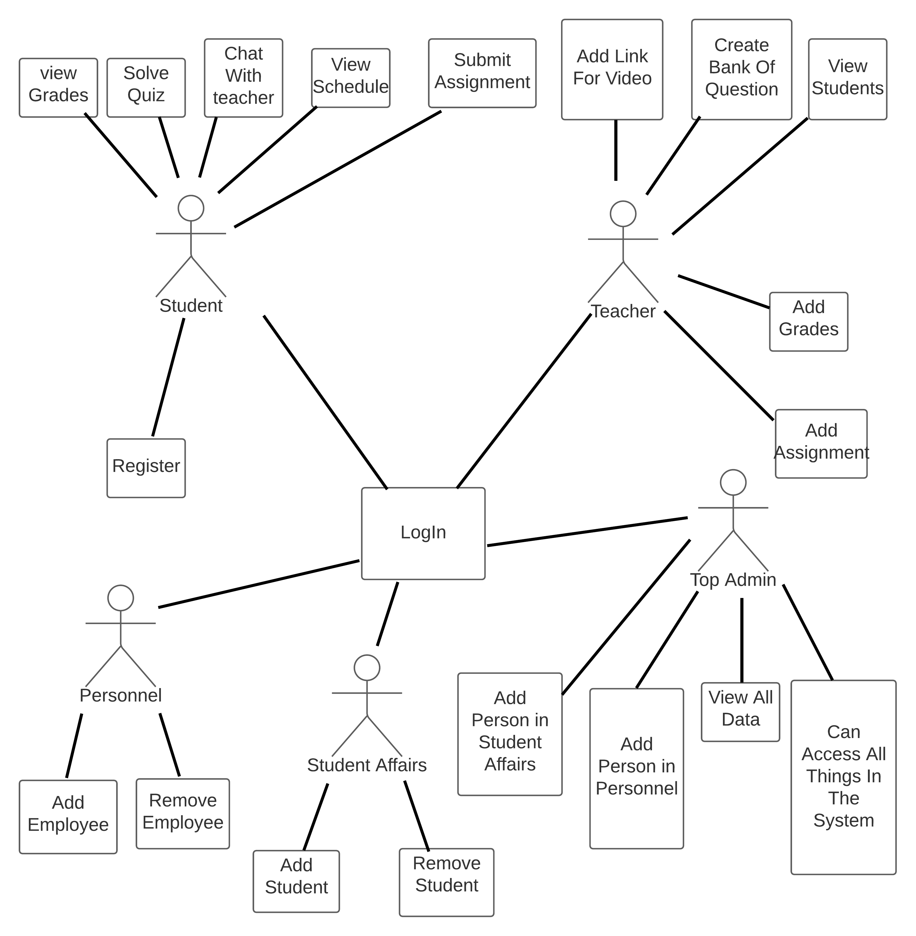
Use Case Diagram:
11

Slide 12
Functional Requirements
12

Slide 13
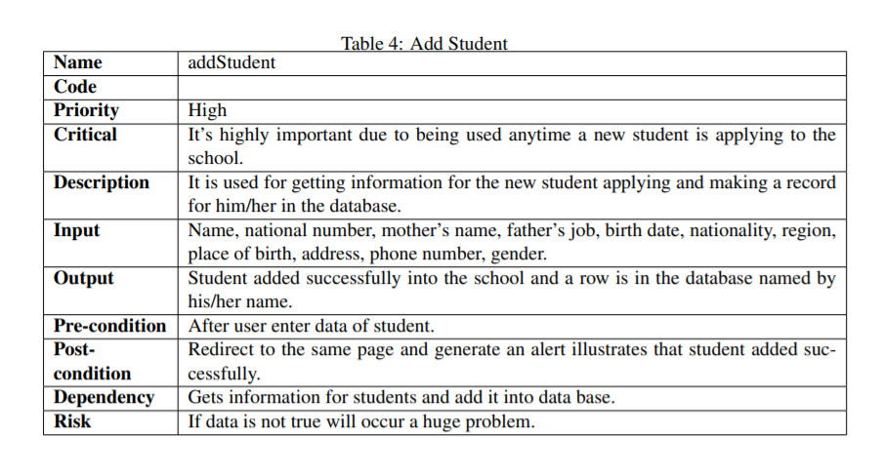
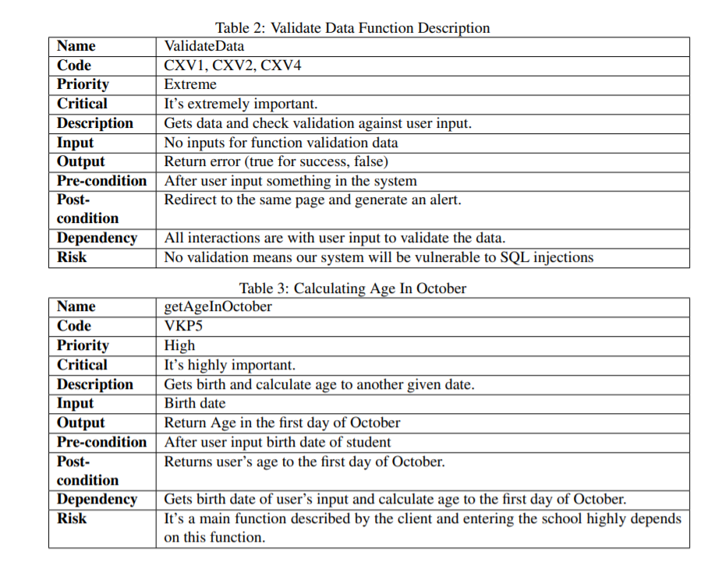
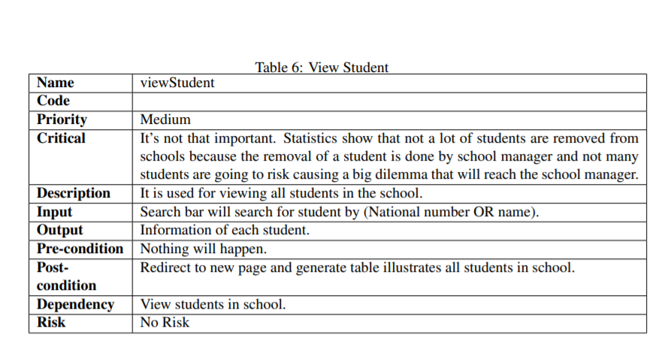
Functional Requirements:
13

Slide 14
Non- Functional Requirements
14

Slide 15






Non-Functional Requirements:
Security
Accessibilty
Availability
Performance
Usability
Hashing
Encryption
MVC
Different Platforms
Offer client’s needs
Ease of use and understanding
Efficient as it should be
15

Slide 16
Database Diagram
16

Slide 17
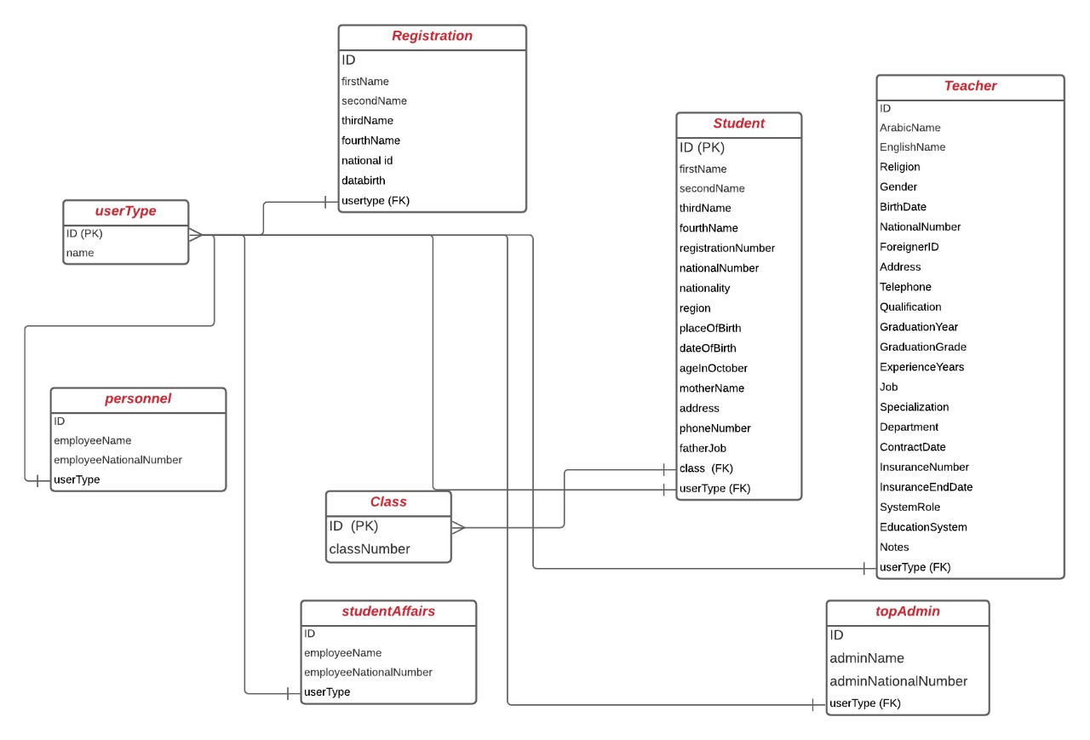
Database Diagram:
17

Slide 18
Class Diagram
18

Slide 19
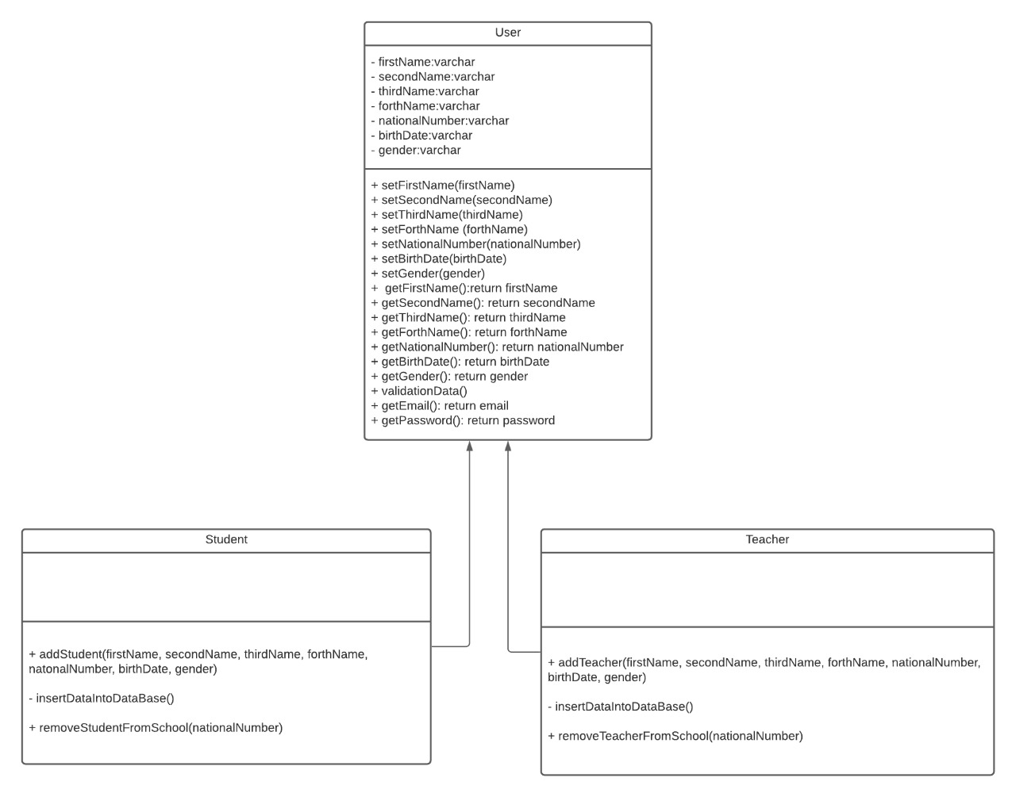
Class Diagram:
19

Slide 20
Wireframes and Prototypes
20

Slide 21
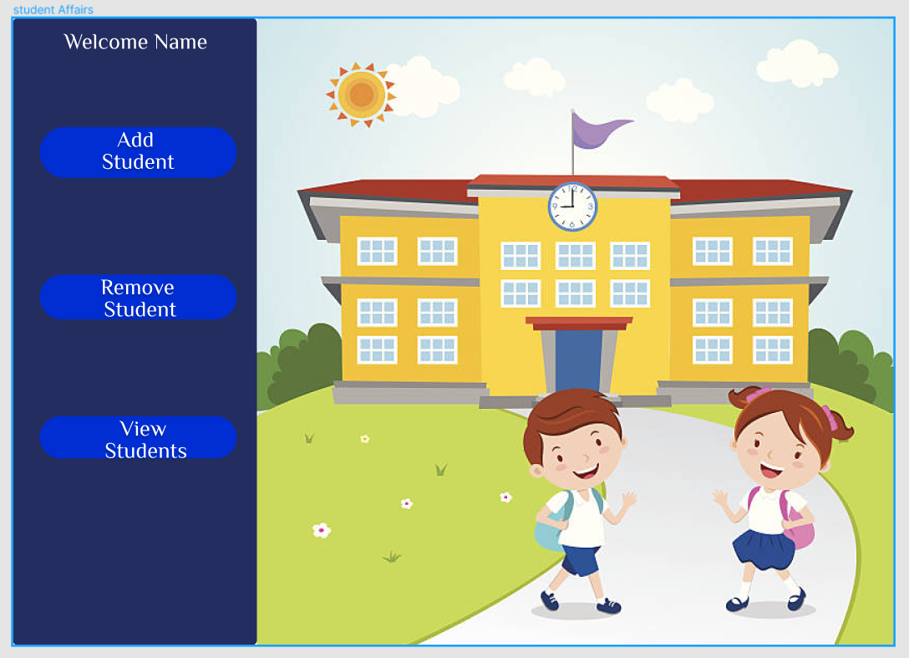
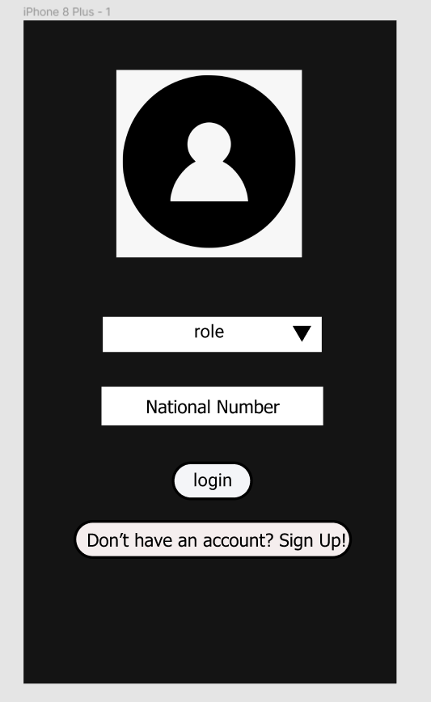
Prototype(1/2):
We gave samples on different platforms.
21

Slide 22
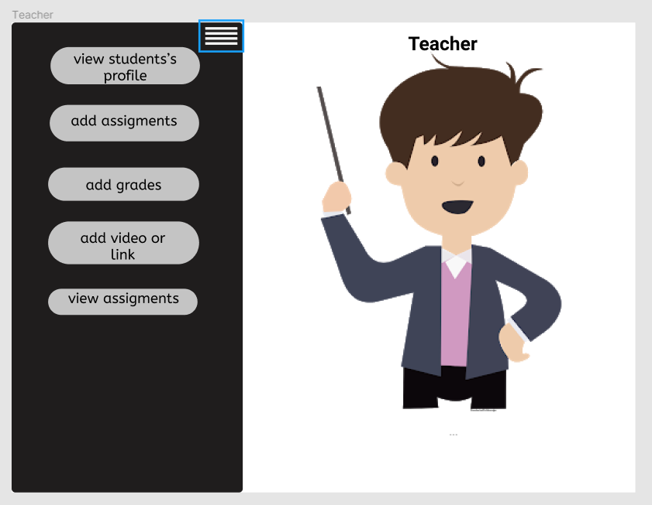
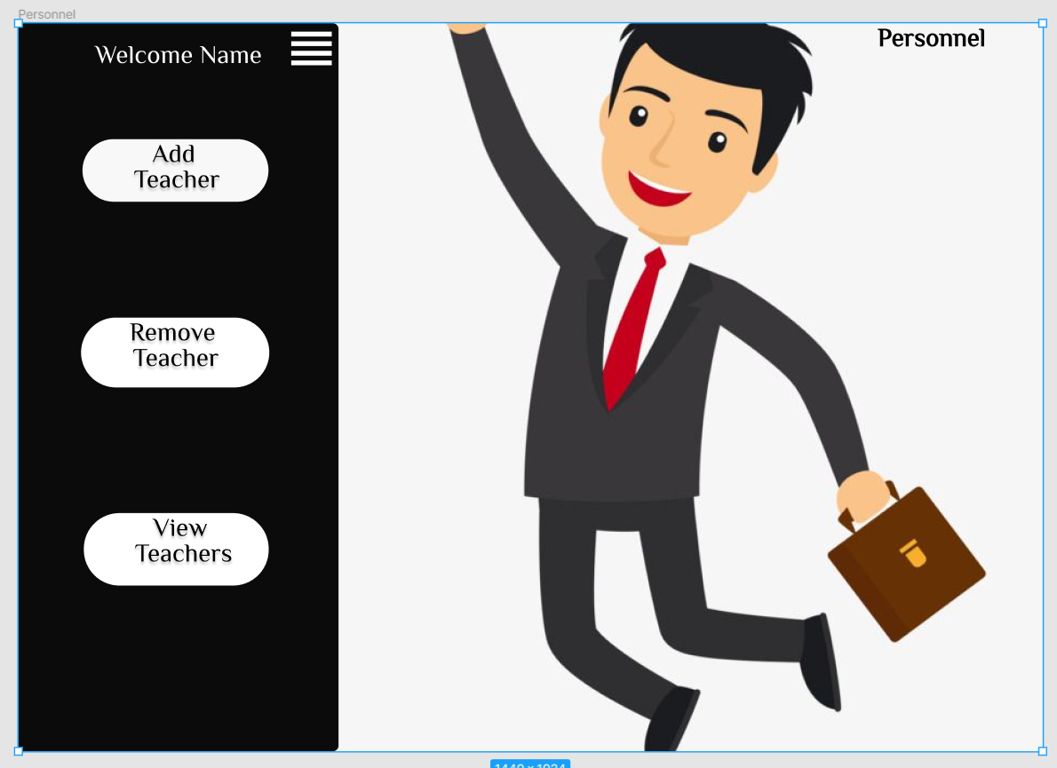
Prototype(2/2):

Slide 23
Live Demo
23

Slide 24


Slide 25
SECOND: HCI

Slide 26
PACT ANALYSIS

Slide 27
People (P)
n Early 2020, the world suffered from some dilemmas due to coronavirus. In addition, everything had gone online. So, students need this online application to solve quizzes, and to be monitored more by teachers. Teachers need this application to make quizzes from a back of questions for students to test their work and monitor them. Besides to student affairs’ and personnel’s manager.

Slide 28
Activities (A)
Teacher and student can register and log in into the system. Besides, teacher can insert a bank of questions and choose random questions from it. Teacher can add grades for the student and view them in his/her class. Student can answer these questions and can chat with his/her teacher, Besides, student can view his/her grades and schedule.

Slide 29
Context (C)
The web application can be used in multiple places. It is mainly used online at home and in school to register.

Slide 30
Technologies (T)
Different platforms with different operating systems like:
Web (PC, Laptops, through browsers)
Android
IOS devices

Slide 31
HTA

Slide 32
Registration
0- Launch Application.
1- Display Home Page.
2- Register for new account by pressing Sign Up.
2.1- Enter the registration credentials and fill in the form.
2.2- Press Create Account => Account Created.
3- Sign In
Student's Assignments
0- Sign In
1- Click on menu.
2- Press on assignments to view.
2.1- Solve all the questions in the form given.
2.2- After finishing, press submit.

Slide 33
View Grades
0- Sign In
1- Click on menu
2- Press on grades to view
2.1- View all his/her grades.
See Recorded Videos
0- Sign In
1- Click on menu
2- Press on see videos to view
2.1- Select the video he/she want to view.
2.2- After finishing, return.
3- View another activities.

Slide 34
Send Messages
0- Sign In
1- Click on menu
2- Press on send messages.
2.1- Find his/her teacher to send message.
2.2- Click the link to send and view all your messages.
2.3- Type your message
2.4- Send Message
3- Now the teacher can check his/her received message.
View Messages
0- Sign In
1- Click on menu
2- Press on view messages.
2.1- Find his/her teacher to reply on message.
2.2- Click the link to reply.
2.3- Type your reply message
2.4- Send Message.

Slide 35
Teacher - Add Assignments
0- Sign In
1- Click on menu
2- Press on add assignments.
2.1- Write your question in its specific text box.
2.2- Add new questions by plus sign button.
2.3- Press Add Questions after finishing writing questions.
3- Now the student may check his/her assignment.
Add Videos
0- Sign In
1- Click on menu
2- Press on Add Video or link.
2.1- Fill in the form credentials (course name, video name).
2.2- Upload your video
2.2.1- Press the add button.
2.2.2- You can update your video status.
2.2.3- You can remove your video.
3- Now the student may check his/her videos section to view the recorded session.

Slide 36
View Answers
0- Sign In
1- Click on menu
2- Press on view answers
2.1- View Students answers.
Student Affairs - Add Student
0- Sign In
1- Click on menu
2- Press on add student
2.1- Fill in the form by the new student's information.
2.2- Click Submit when you finish.
3- Then you may view all students added by pressing View Students

Slide 37
Remove Student
0- Sign In
1- Click on menu
2- Press on remove student
2.1- Select the student you want to remove.
2.2- Click Submit when you finish.
3- Then you may view all students with the update happened by pressing View Students.
View Students
0- Sign In
1- Click on menu
2- Press on view students
2.1- View Students.

Slide 38
Personnel Affairs - Add Teacher(Profession)
0- Sign In
1- Click on menu
2- Press on add profession
2.1- Fill in the form by the new employee’s information.
2.2- Click Submit when you finish.
3- Then you may view all teachers added by pressing View Teachers
Remove Teacher(Profession)
0- Sign In
1- Click on menu
2- Press on remove profession
2.1- Select the teacher you want to remove from the checkbox.
2.2- Click Delete when you finish.
3- Then you may view all teachers with the update happened by pressing View Teachers.

Slide 39
View Teachers
0- Sign In
1- Click on menu
2- Press on view teachers
2.1- Now the personnel affairs employee can view all professions employed in school.
4- Log out

Slide 40
THANK YOU!
Any Questions ?
40

